Slide 1

Jyothy Institute of Technology Forest Ecology and Green Cover Monitoring System
Team Members Project Guide
Name USN Name Designation
Ashwin S 1JT16IS007 Pruthvi Kumar K R Assistant Professor
Kiran S 1JT16IS020 ISE Dept
Sowmya V S Bhatt 1JT16IS052
Sudina K R 1JT16IS054

Slide 2
Abstract
Forests are the precious natural resources which provide us wood, timber tree, human living essentials and it is the place where flora and fauna live. It helps in balancing the eco system.
In order to protect the forest, monitoring is essential.
PURPOSE- The objective of this system is to build a all in one monitoring system that utilizes long range ,low power consumption device LoRa for transmission of data acquired from different ecology monitoring sensors to the forest control room.

Slide 3
Litreature survey
Base papers:-
Real Time Forest Anti-Smuggling Monitoring System based on IOT using GSM from IJARCCE-2019.
IoT based forest fire detection system from IJET- 2017.
Forest Monitoring System Using Wireless Sensor Network from ijasre-2018.

Slide 4
Proposed System
The System is mainly based on Arduino Uno and Raspberry Pi .
Arduino Uno is connected with DHT11 and MQ2.
Raspberry Pi is connected with Pi camera which is used for image processing .
The data is transmitted through LoRa.

Slide 5
System Requirements
Hardware Requirements:
Software Requirements:
Raspberry Pi2
Raspberry Pi Camera Module
Micro SD Card.
Arduino Uno
Battery/ solar panel
Breadboard
LoRaWAN
Proximity sensor
Gas sensor
Temperature and Humidity Sensor
Raspbian OS
Tensor Flow
Open CV
Arduino Uno Language(C/C++)
Python
ThingSpeak

Slide 6
Functional Requirements
User should be able to connect to the device.
A wired connection between components.
Active internet connection.
Installation of libraries.
Continuous power supply.
Accuracy in detection.
A device to receive alert message and monitoring results.

Slide 7
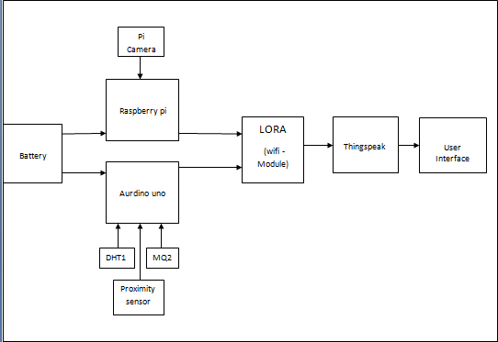
Block Diagram

Slide 8
Methodology and Working
Fire detection using sensors.
Object detection.
Alaraming.

Slide 9
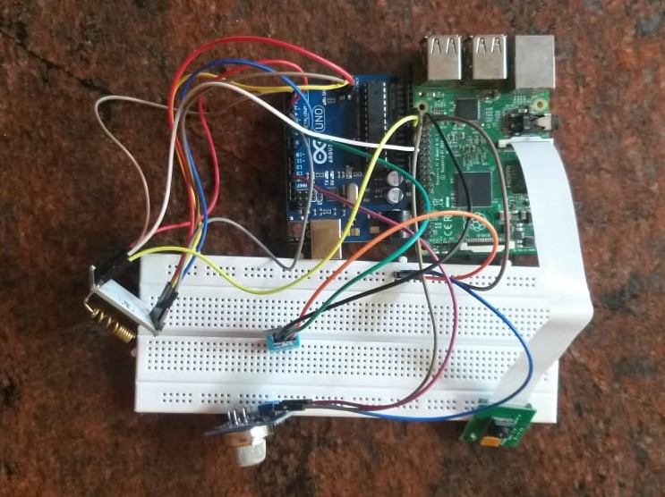
Result and snapshot
The circuit connection of the proposed system

Slide 10
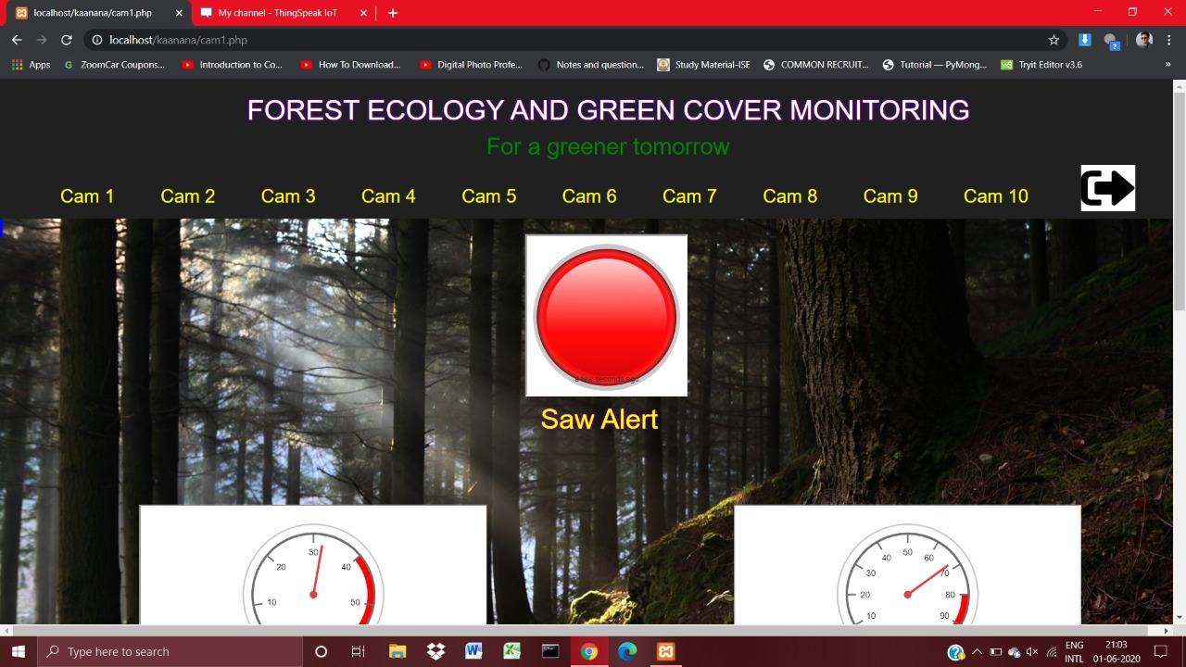
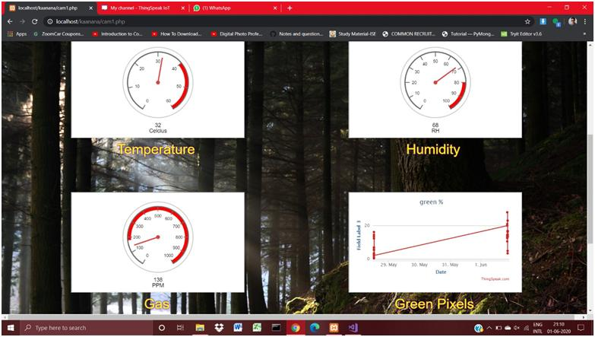
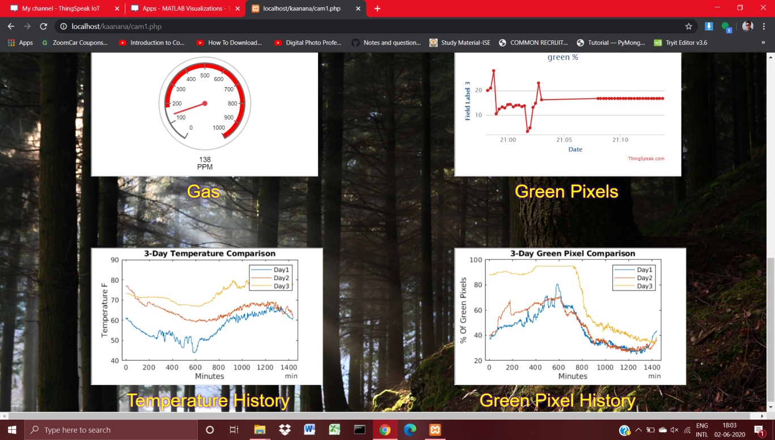
Fig1 saw alert
Fig2 Different sensor readings
Fig4 The comparison graph

Slide 11
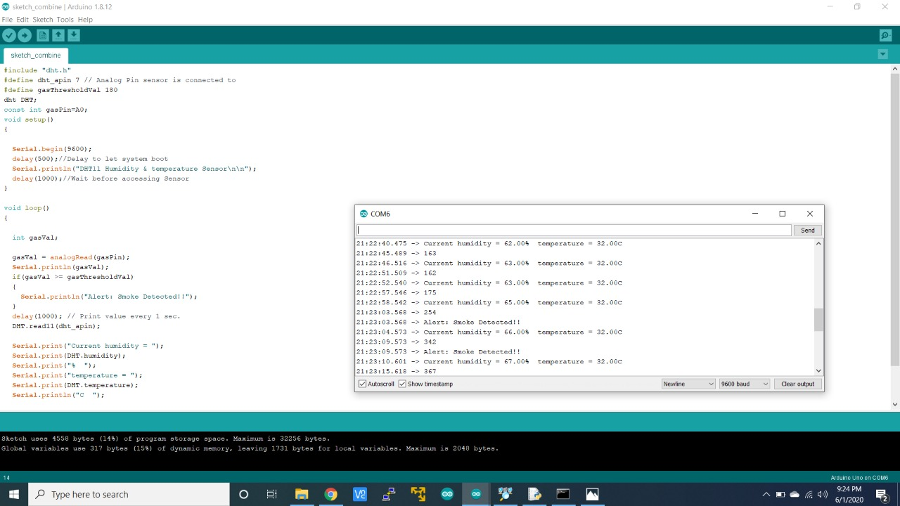
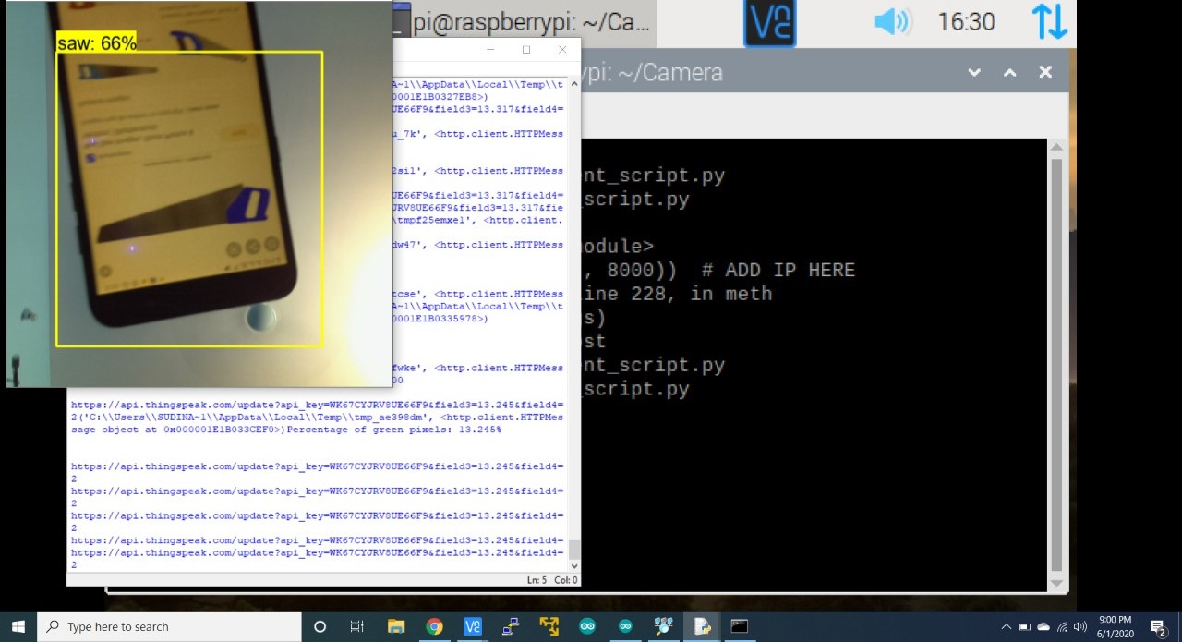
Fig4 The DHT11 and MQ2 output on console
Fig5 The object detection output on console

Slide 12
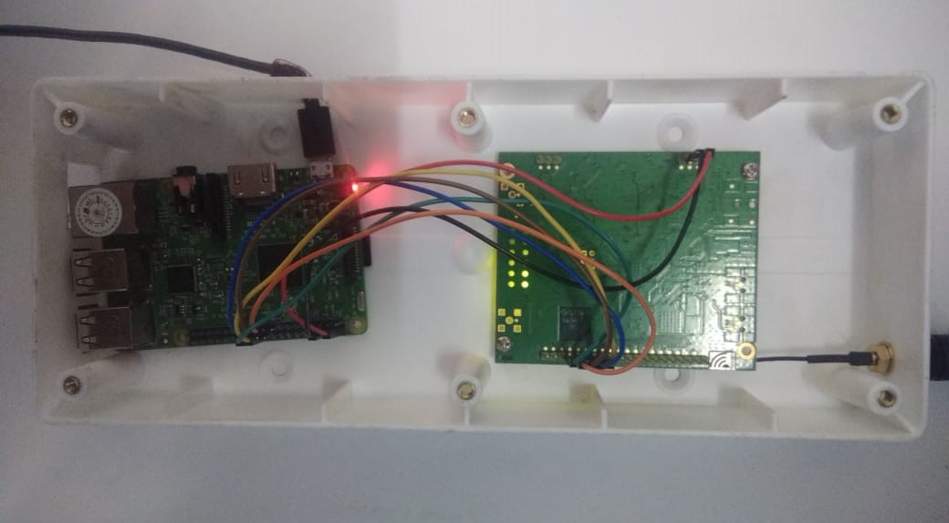
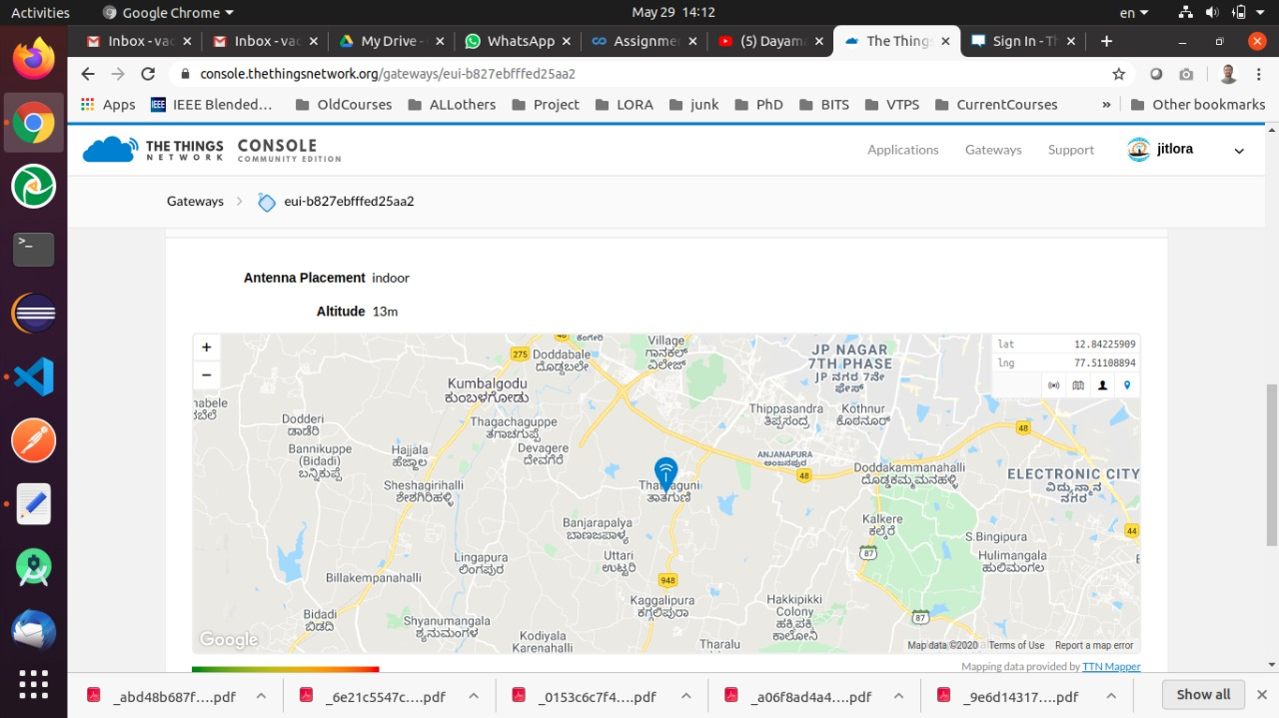
Fig6 The LoRa Module circuit connection
Fig7 The antenna placement location description.

Slide 13
Future Enhancement
The Units / Hardware / Sensors have to be rugged.
To use solar panel for regular power supply.
Suitable enclosure has to be made.
The Module should be placed in untraceable place on trees, not easily accessible to tree-destructors.
Forest Authorities has to be suitably educated.

Slide 14
Q/A

Slide 15
Conclusion
In this system, when the temperature and the flame gets increased alarm will be activated so that the system detects the Wildfire as early as possible before the fire spreads over a large area and prevents poaching.
We have designed a system for Forest Fire Detection which overcomes the limitation of the Existing technologies of Forest Fire Detection.
We also proposed IOT based forest green level monitoring using image processing implemented by Raspberry pi.
Continuous monitoring of green level tells us about the health of the forest

Slide 16
References
Kovacs R., Kiss B., Nagy A., Vamos R., “Early Forest Fire De-tection System For Vegetable Fire in the AggtelekNationalPark”, Budpest, Hungary,2004
Kelha V., Rauste Y., Buongiorno A., “Forest Fire Detection bySatellites for Fire Control”, European Space Agency, Finland, 2000
Manyangadze T., “Forest Fire Detection for Near Real Time Monitoring using Geostationary Satellite”, International Institute for Geo-information Science and Earth Observation, Enschede, Netherland, 2009
Son B., Her Y., Kim J., “A Design and Implementation of ForestFire Surveillance System based on Wireless Sensor Network forSouth Korea”, International Journal of Computer Science andNetwork Security, Vol 6 No. 9B, September 2006
Hariyawan M.Y., Gunawan A., Putra E.H., “Wireless SensorNetwork for Forest Fire Detection”, ISSN:1693-6930,Vol. 11, No. 3, pp. 563~574, September 2013

Slide 17
THANK YOU

